Slide 1
JS HTML DOM
Week 2, Day 3

Slide 2
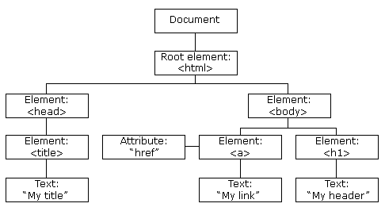
HTML DOM
Document Object Model
Represents HTML elements as JavaScript objects
Allows us to dynamically add, remove, and modify HTML elements and their CSS styles

Slide 3
Review: Element and Content
document.getElementById(“id1”)
Element object
.innerHTML property
Content of the element
<div id=”id1”>Content goes here.</div>
document.getElementById(“id1”).innerHTML = “Hello.”;

Slide 4
Getting Elements
.getElementById(“id1”)
A single element
.getElementsByTagName(“p”)
A list of elements
.getElementsByClassName(“class1”)
A list of elements
<div id=”id1”>
<p>hi</p>
<p>bye</p>
</div>
<p>wow</p>
var allp = document.getElementsByTagName(“p”);
var x = document.getElementById(“id1”);
var somep = x.getElementsByTagName(“p”);
allp[2].innerHTML = “thanks”;
somep[0].innerHTML = “hello”;

Slide 5
Changing Contents and Attributes
Changing contents
.innerHTML property of the element
Changing attribute values
.attributename property
<a href=”https://www.google.com/”>
Click here.
</a>
var element = document.getElementById(“id1”);
element.innerHTML = “CLICK!”;
element.href = “index2.html”;

Slide 6
Changing CSS Styling
Changing a style property
.style.propertyname
<div id=”id1” style=”width:100px; height:100px; background-color:red;”></div>
var element = document.getElementById(“id1”);
element.style.background-color = “blue”;

Slide 7
Document Tree Navigation
Terminologies: node, root node, parent, sibling, child
Every element (except for root) has one parent
A sibling is any element that shares a parent

Slide 8
Document Tree Navigation
Properties
.parentNode
.childNodes
List of nodes
.firstChild
.lastChild
.nextSibling
.previousSibling
<html> <head id=”id1”> <title>DOM Tutorial</title> </head> <body> <h1>DOM Lesson one</h1> <p>Hello world!</p> </body> </html>
document.getElementsByTagName(“p”)[0]
document.getElementById(“id1”).nextSibling.lastChild

Slide 9
Text Node
Text contents inside of elements are also nodes (called text nodes)
The content of a text node can be accessed with .nodeValue
.innerHTML is equivalent to .firstChild.nodeValue
<html> <head id=”id1”> <title>DOM Tutorial</title> </head> <body> <h1>DOM Lesson one</h1> <p id=”id2”>Hello world!</p> </body> </html>
document.getElementById(“id2”).innerHTML
document.getElementById(“id2”).firstChild.nodeValue

Slide 10
Adding and Removing Nodes
document.createElement(“tagname”)
Creates an element node
document.createTextNode(“text”)
Creates a text node
parent.appendChild(newChild)
Appends node as the last child
<div id="div1"> <p id="p1">This is a paragraph.</p> <p id="p2">This is another paragraph.</p> </div>
var para = document.createElement("p"); var node = document.createTextNode("This is new."); para.appendChild(node); var element = document.getElementById("div1"); element.appendChild(para);

Slide 11
Adding and Removing Nodes
parent.insertBefore(newChild, existingChild)
Appends node as previous sibling of child
<div id="div1"> <p id="p1">This is a paragraph.</p> <p id="p2">This is another paragraph.</p> </div>
var para = document.createElement("p"); var node = document.createTextNode("This is new."); para.appendChild(node); var element = document.getElementById("div1");
var child = document.getELementById(“p2”); element.insertBefore(para, child);

Slide 12
Adding and Removing Nodes
parent.removeChild(child)
Removes the child from HTML
<div id="div1"> <p id="p1">This is a paragraph.</p> <p id="p2">This is another paragraph.</p> </div>
var element = document.getElementById("div1");
var child = document.getElementById(“p1”);
element.removeChild(child);

Slide 13
Lab
Create a button that generates random number between 0 to 1
Create <img> that changes back and forth between two different images when you click (changing HTML)
Create a div (100px by 100px) that changes between two colors when you click (changing CSS)
Create a button that disappears when you click it

